Slide 1
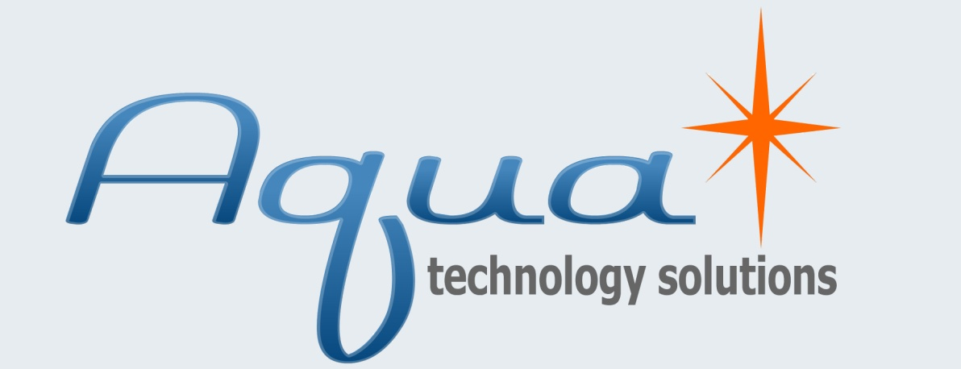
Springboard Presentation
8093 6744 1072 9572
7338 1179 7742 0064
9410 1149 5382 0229
July 10th, 2007
CONNECT Springboard
Proprietary & Confidential

Slide 2
Springboard Presentation
8093 6744 1072 9572
7338 1179 7742 0064
July 10th, 2007
CONNECT Springboard
Proprietary & Confidential
Notes:
Hi, I’m Steve Kozyk Founder and CEO of Aqua Technology Solutions. For the last 8 and a half years I’ve lived and breathed the credit card event marketing industry serving as a college campus credit card marketing rep, the founder of a card marketing firm, and a consultant working with issuers such as Citibank, MBNA, Discover. -----------------------
If you consider filling out a paper credit card application at a ballgame, college campus, or even at a trusted retail store, remember the individual taking your application is a complete stranger usually paid a low income wage and will have complete control over your personal information.
Predatory marketing practices

Slide 3
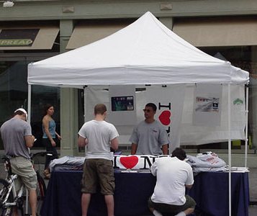
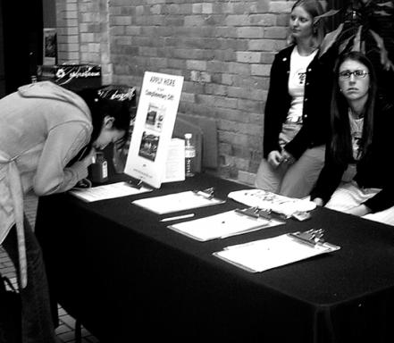
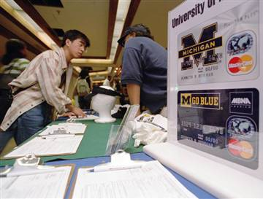
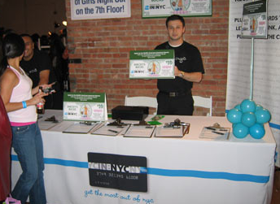
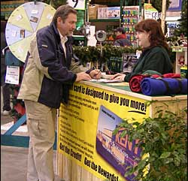
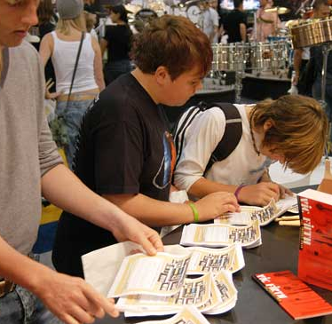
8093 6744 1072 9572
7338 1179 7742 0064
Credit Card
Event
Marketing
CONNECT Springboard
Proprietary & Confidential
Notes:
Event marketing is used by credit card issuers to get people to sign up for credit cards at events such as ballgames, concerts, and college campuses. Millions of students nationwide during the last decade who have signed up for a credit card on campus have been either the victim of identity theft or fraud. Credit card marketing reps get paid commission for the number of applications they get students to fill out usually $1 to $5 per application. It’s common everyday practice for marketers to transfer student’s personal information on to addition applications, sometimes a dozen or more to give themselves extra commission. Just a few miles from here in Kearny Mesa, their was a warehouse that employed 30 individuals who’s job was to copy San Diego area students’ personal info to as many additional applications as possible. This type fraud has a dramatic effect on students credit and financial future and is estimated to cost issuers more than $50 million annually. Issuers don’t have an effective solution to stop it. This is why I started Aqua Technology, to immobilize application fraud & identity theft while greatly improving the issuers credit card portfolio bottom line.

Slide 4
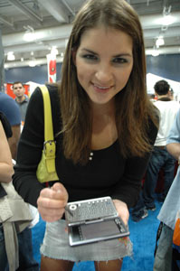
8093 6744 1072 9572
7338 1179 7742 0064
The Future
Of Event
Marketing:
Aqua
CONNECT Springboard
Proprietary & Confidential
Notes:
Aqua Technology intends to change the future of how new credit card accounts are acquired at events by eliminating paper applications replacing them with our highly secure, streamlined paperless technology solution. I really appreciate all of you taking time out of your day today to be here and I’m looking forward to sharing some exciting things with you about Aqua’s paperless solution.

Slide 5
Questions
8093 6744 1072 9572
7338 1179 7742 0064
What should be our go to market strategy?
What is the most effective marketing collateral to reach potential clients?
How do we build credibility as a start-up?
CONNECT Springboard
Proprietary & Confidential
Notes:
The reason why I’m here today and why Aqua Technology initially got involved with Springboard is to answer these key questions.

Slide 6
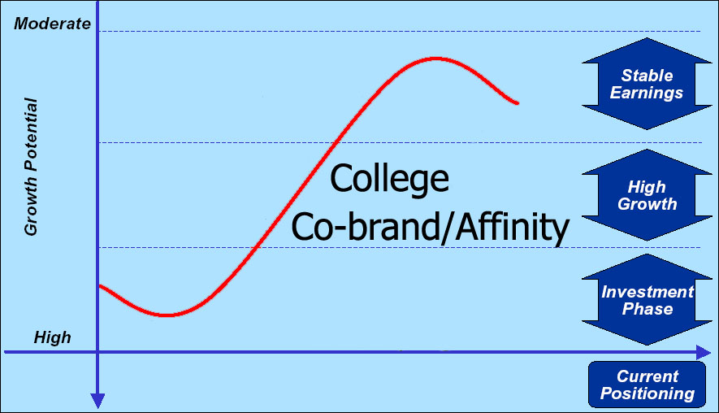
Market: Credit Card Event Marketing
8093 6744 1072 9572
7338 1179 7742 0064
Credit card industry $145.3 billion
Aqua’s segment: event marketing channel- $1.45 billion
Event channel in high-growth phase
College segment is never saturated with high profit potential
Aqua’s market controlled primarily by top 5 issuers
1 issuer would provide 17% market access
1-2% of issuers cards are produced from the event channel, Credit Card Management magazine
CONNECT Springboard
Proprietary & Confidential
*Adapted from “Citi Acquisition of Sears’ Credit and
Financial Services Business” summary.
Notes:
Market:
From an ROA standpoint, the credit card industry is the most profitable industry in the US with profits totaling $38.6 billion while generating $145.3 billion in revenue. With the average US family having over 8 credit cards the overall CC market is nearing saturation and has matured. On the other hand the segment of this market Aqua plays in, the event marketing channel which is 1% of the overall market or 1.45 billion, is currently positioned in a high growth phase according to top issuers. Within the event channel, the college segment is especially appealing because it can never be saturated; everyday new credit consumers are created when they turn 18. It currently costs some issuers $200 to acquire a new account at an event which has resulted in five of the largest issuers controlling about 80% of the event market. These issuers are our primary target clients and partnering with just one would provide Aqua access to 17% of the market
-------------------------------
CC Industry 2006: Net pretax profit totaled $38.6 billion, with a 4.6% return on assets. Expenses dropped 1.7%--to $106.7 billion--last year, while revenue grew to $145.3 billion
“The credit card industry took in $43 billion in fee income from late payment, over-limit and balance transfer fees in 2004, up from $39 billion in 2003” http://www.creditcards.com/statistics/statistics.php
http://www.harpers.org/Finance.html
full-time college students control in excess
of $19 billion in annual discretionary spending
is caused by unchecked fraud, identity theft, and inefficiency. realizing it’s full profitability potential.

Slide 7
Market Pain
8093 6744 1072 9572
7338 1179 7742 0064
Pain: ID theft, application fraud, & high costs of paper
- “Soft ID theft” committed by marketing reps
- Application fraud committed by applicants and reps
Identity theft, fraud, and inefficiency in the event channel cost issuers >$50 million annually
Paper application use is root cause
CONNECT Springboard
Proprietary & Confidential
Notes:
Pain:
With credit cards, most people think of identity theft as someone using another’s personal information to falsely obtain a credit card and then make fraudulent purchases. Another type of ID theft plaguing the CC industry, I like to call “soft ID theft”, occurs when field marketing reps copy personal information from a legitimate CC application and use it to sign up the individual for additional credit cards or other service for financial gain. Another pain is application fraud which comes in two flavors. First, issuers have cited up to 20% of applicants themselves purposely provide false information in order to receive a free gift for signing up, like a T-shirt or ball cap, knowing they’ll never receive a card costing the industry about $12 million in wasted gift expenses annually. Second, because most reps get paid commission only for 100% complete applications, it is common practice for reps to arbitrarily fill in any missing information on applications to ensure they get paid. Paper application printing, distribution, and data entry also represent significant expenses. When combined, Id theft, application fraud, and paper inefficiencies cost the credit card industry over 50 million a year according to?????. The archaic use of paper applications are the root cause of this pain.
-------------------
The best interests of the individuals marketing cards are not the same the issuer
T&C Education materials must be viewed, rebuild poor image.
Issuers tolerate these huge losses because of, A) The organic growth the channel generates and B) Issuers simply have never successfully formulated an effective solution to combat these problems.
In recent years identity theft has become an increasingly large problem in our society. How many of you have been yourself or know someone who has been a victim of identity theft?
In 2006 identity theft cost Americans 56.6 billion dollars of which 73% of these cases involved credit card fraud. In the event channel, ID theft alone cost issuers $$$ annually.
“Soft ID Theft” committed by marketing reps
Application fraud committed by applicants and reps
Paper applications costs are significant
Lower approval rates than expected for a given demographic credit profile
No one knows the true cost of these types of fraud on the industry, but one thing is certain;
Notes: Identify Marketing rep fraud. Low approval rates w/paper apps. 50 billion paper applications are wasted each year with shipping costs of well over 1 billion
is Marketing reps committing fraud & ID theft. High cost to print, ship, and data enter paper applications

Slide 8
Current Approach
8093 6744 1072 9572
7338 1179 7742 0064
Paper Shipped
Credit Card
Issuer
Marketing
Firm
Verbal Reporting
8093 6744 1072 9572
Paper Shipped
Paper Credit
Card Application
Field Marketing Rep
7
CONNECT Springboard- Proprietary & Confidential
Notes:
You might find this hard to believe in a market with 1.45 billion at risk, but issuers don’t really control how their cards are marketed at events. Most issuers contract outside event marketing firms. They print then ship applications to these firms who in turn ship them to their individual marketing reps in the field. Once an application is shipped to the field, if the issuer wants to make a change to the application, for example the terms and conditions, it is very costly and unrealistic to recall all applications and redistribute new ones. Completed applications are then overnight shipped back to the marketing firm from the field, data entry is performed, and the paper eventually shipped back to the issuer. When issuers need information about their current marketing efforts, they are forced to trust marketing firms, who get their information verbally from the field reps, to relay accurate data about their current marketing efforts. Todays event marketing process is highly inefficient, prone to errors and exploitation, and is almost never executed as mandated by the issuer. CALL Media Source to find out where event market info can be found.
-----------------------------
Paper applications are still used today almost exclusively in the event channel; little has changed since it’s inception in the late 80s. Applications are printed, then shipped to marketing firms and in turn shipped to the individual marketing reps in the field. A “one size fits all” static application is used to accommodate a wide variety of different events. Reps are compensated by the quantity of FULLY completed applications they produce which creates an environment which quality is sacrificed in favor of quantity. Incomplete applications are frequently taken by reps to increase throughput while any missing information is filled in later by the rep. Applications are then overnight shipped back to the marketing firm from the filed, data entry is performed, and the paper eventually shipped to the issuer. This entire process is highly inefficient, prone to errors and exploitation, and is almost never executed as mandated by the issuer.
. In other words, the issuers has no idea who is actually representing their company face to face to the public.

Slide 9
Aqua: An Innovative Approach
8093 6744 1072 9572
7338 1179 7742 0064
Aqua’s Server
Aqua Manager
Credit Card
Issuer
Aqua Reports
8093 6744 1072 9572
IDsyncTM Technology
ID Verification, Credit Scoring, Compliance
Partners
EV-DO Network
Field Server
Digital Credit
Card Application
DynamicSwitchTM
Architecture
CONNECT Springboard- Proprietary & Confidential
Notes:
Now I’d like to tell you about a much better approach. Aqua Technology eliminates paper applications replacing them with a wireless digital application system that is administered at events via hardware devices such as laptops, tablet PCs, or self-serve kiosks. While a person is applying on a device, Aqua can perform several instant data checks through our proprietary IDsync Technology including identity verification, address validation, and credit scoring linking the mobile event in the field directly to world leading information providers such as LexisNexis and FairIsacc. Once an application is verified and fully completed it is encrypted and securely transferred to a central field server. Taking advantage of EV-DO mobile wireless networks, such as Verizon’s Nationwide Broadband, we upload all application data from the field to Aqua’s remote Managed Server and onto the issuer. All data is handled in compliance with Payment Card Industry security standards, The Office of Foreign Asset Control, and Patriot Act section 326. If and when wireless connectivity is degraded or unavailable, Aqua’s DynamicSwitch Architecture seamlessly allows all data to be archived on the Field Server until reliable connectivity is once again established. Our DynamicSwitch Architecture differentiates us from our competitors by allowing our solution to function seamlessly in a truly mobile environment independent of network connectivity. We provide issuers real-time, transparent access to key information regarding all aspects of their event marketing efforts via Aqua’s powerful (advanced analytics) reporting tool including the option to visually monitor all live event locations from their desk via web cams in the field. This eliminates the expensive of auditors physically traveling to the field (to inspect setups). Remotely the issuer can also easily make real-time changes to the application process at any specific event location in the field. They can change the APR, terms & conditions, for each event location as often as they like. Aqua’s solution will raise the stakes for the industry and allows the issuer access to their market in a much more transparent and dynamic way.
------------------------
All application data is safeguarded under PCI or Payment Card Industry data security standards and fulfills at a minimum the issuers’ baseline Patriot Act Section 326 and Office of Foreign Asset Control compliance requirements.
Advanced analytics
uses an electronic template to record all applicants’ details which are immediately encrypted and securely downloaded to Aqua’s using a wireless connection. Each application is processed in real-time using a number of data checks including techniques. This allows the system to notify the field sales representative of any issues relating to the client’s application while it is still being completed.
Capturing application data electronically at the source eliminates any manual keying requirements and customer data is captured more accurately and more completely. Real-time validation enables straight thorough processing, and the costs associated with processing and managing paper-based applications are eliminated.
Aqua’s solution can also be adapted to enable remote data collection for many other applications such as marketing surveys, housing reports, stock market transactions and tracking inventory levels.
Aqua Technology has partnered with world-leading information providers such as LexisNexis and Fair Isaac to integrate instantaneous identity verification, credit approval, while fulfilling many compliance requirements within the framework of our technology.
Applications are no longer handled by the marketing reps, data entry errors are a thing of the past.
PCI or Payment Card Industry standards
Topics Covered on Slide: (Will Animate???)
Technology- Will make new diagram focusing on CA of Aqua’s technology including:
Realtime Identity Verification & credit scoring
Perripheral Support (ID Scanner,sig pad, etc.)
Realtime Remote Management
Imbedded video advertising
Custom marketing options per event
Remote IT support
Compliance Fullfilment
Technology:
Describe the unique technical differentiators. Try to address the why now question.

Slide 10
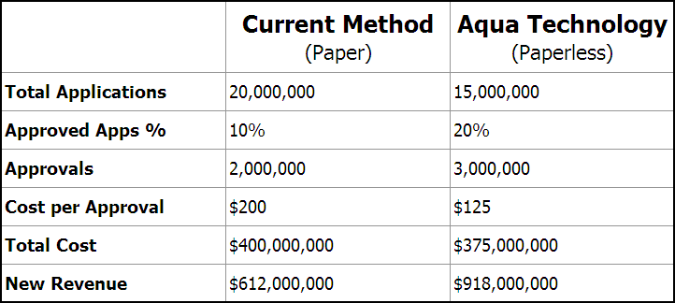
Value Proposition
8093 6744 1072 9572
7338 1179 7742 0064
Increased credit card portfolio profitability while decreasing identity theft, fraud, and account acquisition costs.
*Diagram illustrates current industry wide metrics compared to forecasted metrics if Aqua Technology’s solution is adopted.
CONNECT Springboard- Proprietary & Confidential
Notes:
What Aqua’s digital solution means to the issuer is the virtual elimination of application fraud and “soft” ID theft and the complete elimination of the high costs of paper applications resulting in increased credit card portfolio profitability. When comparing the current paper method against Aqua Technology’s digital solution, we deliver approximately 25% less completed applications. This occurs because fraudulent and incomplete apps are taken out of the equation before they get to the issuer. However, test pilots we performed on local college campuses showed the number of applications that are ultimately approved, the metric most important to issuers, increased by over 50%. This would create over 50 M in new annual revenue while cutting expenses by 25 M for our issuer partner.
--------------
May 07 70% of Americans are regular internet users increased from 44% in 2000: http://www.internetworldstats.com/america.htm , http://www.internetworldstats.com/am/us.htm
This would reduce the issuers’ average cost per approval by over 60% while creating 306 million in new revenue. If one of the top issuers adopted our solution for their event channel, on average they could expect an increase of 52 M in new annual revenue generated while saving 5 million in costs.--------This would reduce the issuers’ average cost per approval by over 60% while ultimately creating 52 M in new annual revenue for our issuer partner
As in the history of warfare, those who posses the technology advantage redraw the map.
Issuers can’t afford to…
Traditionally this information must be requested in advance from their marketing partner and is subject to the firm’s records accuracy and best interests. We also allow the issuer to dynamically adjust the terms and conditions of their credit card programs on the fly depending on any market factor including the current prime rate, overall credit profile of a specific marketing location, or the present competitive nature of the marketplace.
and because most consumer caused fraud will eliminated due to real-time IS verification. It’s also important to note that during periods of higher than expected number of individuals attempting to apply simultaneously, bottlenecks can occur due to the limited number of digital card application enabled hardware devices available.
because applicant and marketing rep fraud is virtually eliminated.

Slide 11
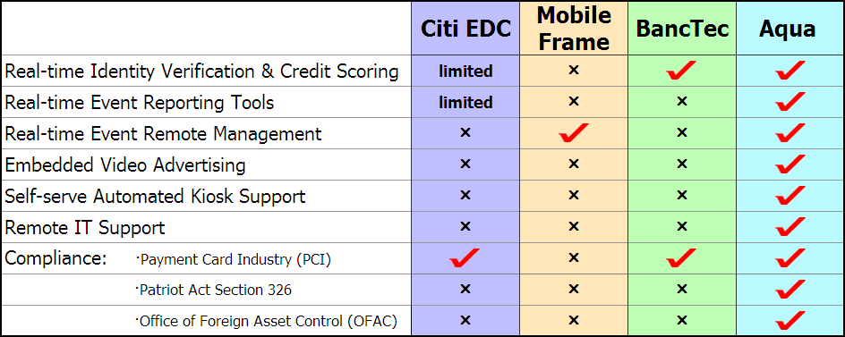
Competition
8093 6744 1072 9572
7338 1179 7742 0064
Citibank- credit card issuer
MobileFrame- mobile data capture
BancTec- information processor for issuers
CONNECT Springboard
Proprietary & Confidential
Notes:
Aqua Technology and each of our competitors all have distinctly different business models, even though our basic solutions are similar.
Citi, Issuer- Designed their solution top-down from an issuer’s point of view, has poor static user interface and is difficult for reps and the general public to use resulting in unnecessary downtime and poor production, but have successfully reduced fraud & ID theft. Developed as an In-house solution solely for the college segment, not competing with Aqua Technology in the broader market.
MobileFrame, Mobile data capture- They have a dynamic product based on a strong technology backbone serving a wide variety of industries. But it is a one size fits all solution and are not currently addressing the CC market.
BancTec, Information processor for issuers- Identified their client’s need for paperless technology, in response built inflexible PDA based UI , but with strong backend linking to issuer. Like Citi, designed top-down.
Aqua Technology provides the issuer the ability to manage the application process and view key program metrics for each individual event remotely and in real-time which is a fundamental advantage for our solution. Lift the veil….The current marketing process run by outside firms, is fairly “black box” to the issuer whereas our solution allows full transparency and customization of operations, something none of our competitors provide. Investing in a technology based solution and then having it breakdown in the field has been expressed by issuers as a major. In response, Aqua developed remote IT support to solve most technical issues anywhere they occur in the field and perform software upgrades from any remote location. During periods when applicants aren’t using a particular hardware device to sign up, the default state of the machine shows advertising content geared toward the specific demographic being targeted. The flexibility of our technology framework also allows us to easily install our solution in a self service kiosk that can automatically dispense a gift or take payment for fee based card programs. Because our solution is tailored for a very specific industry application with a powerful set of features our competitors don’t currently possess, we feel we have at least a 6 month lead to market.
----------------------
Advertising content can be modified remotely whenever a representative is connected to the internet.
In addition to these critical advantages, Aqua provides enhanced
Sysnopsis: Aqua’s only US based competitor currently in the CC market is Citi’s in-house solution although MobileFrame could jump in the game if they had an understanding of the market. Aqua’s system costs a few thousand more than Citi’s, but through testing of both systems Aqua’s technology produces three times the application output and saves 25 mins in setup time each day at an event.
Banctec doesn’t serve US market
CitiGroup is the only issuer currently using paperless application technology at events. They developed a proprietary, in-house solution designed solely for the college segment producing mixed results. Although they've successfully reduced fraud & ID theft, they have greatly reduced their overall production due to continuous technical problems and poor system design resulting in rep and applicant usability issues. MobileFrame may be in the best position to eliminate Aqua after launch because their core business is mobile data capture and could theoretically modify the framework of their technology for credit card account acquisition. They offer solutions for a wide spectrum of industries, but to date have failed to develop a solution for the credit card industry. BancTec has been in business with European issuers for over 3o years. Identifying issuers need for a paperless credit card acquisition solution, they built an inflexible PDA based acquisition system.
Probably the best candidate to be Aqua’s would be copy-cat.
(highlight features or competitor on chart as I speak about them?)

Slide 12
Why Aqua? Why Now?
8093 6744 1072 9572
7338 1179 7742 0064
2000 2007
Regular internet users: 44% 70%
Hardware unit cost: $1500 $500
National broadband coverage: n/a
CONNECT Springboard- Proprietary & Confidential
Notes:
Why haven’t issuers jumped on digital? The first thing to consider is anyone who can read and write can fill out a paper form, and until very recently, the numbers showed the public may not have been receptive to digital . Secondly the initial cost to develop and deploy technology has been high compared to risk. Today with 70% of Americans now being internet savy and the cost to deploy paperless technology decreasing by almost 70% since 2000 coupled with exponential growth in national mobile broadband coverage, the time for paperless technology has arrived. What sets Aqua’s solution apart from our competitors is that we focus on a niche market using proprietary technology that is already developed based on a unique
--------------
May 07 70% of Americans are regular internet users increased from 44% in 2000: http://www.internetworldstats.com/america.htm , http://www.internetworldstats.com/am/us.htm
the majority of Americans were not regular computer users. devices and if low paid field reps could adequately manage technology in the field
Both of these factors have recently reached a level of convergence with an acceptable amount of risk issuers are willing to take. Mobile broadband coverage.
Perceived security of technology

Slide 13
Team
8093 6744 1072 9572
7338 1179 7742 0064
Steve Kozyk- CEO/ Founder
credit card event marketing
marketing rep, marketing firm founder, issuer consultant
Khaled El Henawy- CTO
software development and mobile data technology
Developed financial intranet, database reporting & remote network monitoring system
Kurt Kandler- VP Business Development
credit card industry and co-brand/affinity card programs
MasterCard Global Cobrand Development Lead
CONNECT Springboard
Proprietary & Confidential
Notes:
Aqua Technology’s key man team is unique in that we have over 50 years experience in the three industries needed for success, credit cards, event marketing, and mobile data. As mentioned my experience is in the credit card event marketing industry from the bottom of the food chain to the top. Khaled working for companies like IBM, MCI, and AEGON has developed a highly secure financial intranet, a remote network monitoring system, and a proprietary database reporting tool currently used by a number of fortune 500 companies including IBM. Khaled has been continuously developing his reporting tool over the last decade and has integrated it into the framework of Aqua’s technology. Kurt Kandler was involved in the successful formation of over 100 new card programs working for MasterCard as head of global co-brand development. Working directly with dozens of issuers, Kurt has strong ties to the industry and understands their sales cycle. We are currently in the process of recruiting additional experience to our team and a board of advisors that can influence our organization in a positive way.

Slide 14
Risks
8093 6744 1072 9572
7338 1179 7742 0064
Evolving wireless network coverage renders technology obsolete
Tighter US credit card industry regulation drastically shrinks our market
Launching without securing major credit card issuer partner
CONNECT Springboard
Proprietary & Confidential
Notes:
Aqua’s greatest challenge is convincing a major issuer that Aqua as a relatively unknown commodity can successfully execute our solution. We were invited by two of the top five issuers to present our solution and both expressed this as their major concern. If partnering with an issuer out of the gate isn’t an option, we will seek strategic partnership opportunities with organizations that already have a strong existing partnerships with top issuers. As wireless coverage becomes more widely available and reliable through emerging technologies like WiMAX and multi-RF mesh, our dynamic switch architecture technology edge will diminish. It is our belief however that we will establish ourselves in the market before this occurs and will actually become an asset as our technology evolves. The credit card industry is facing increasing pressure from Congress and most experts believe its only a matter of time new laws will be enacted limiting many of the so-called profiteering practices of the industry. This will most likely lead to reduced marketing spend, issuers taking less risks in the marketing arena, and can effect how Aqua is compensated. The sooner we enter the market and prove our model, the less we will be effected by these potential changes.
--------------------------------------
This will help us address the market credibility issue and strengthen our marketing strategy.
Another question I get asked is, “why can’t you just deploy a device that has a web based CC application?”.
The reps are almost always independent contractors
As other Western countries have tightened regulations on issuers, a number of foreign issuers have recently entered the US market to take advantage of our lax regulations. Once we gain a foothold in the market, other facets of our solution will eventually emerge as more ..

Slide 15
Questions
8093 6744 1072 9572
7338 1179 7742 0064
What should be our go to market strategy?
What is the most effective marketing collateral to reach potential clients?
How do we build credibility as a start-up?
CONNECT Springboard
Proprietary & Confidential
Notes:
And this concludes my presentation. I appreciate all of you taking time out of your day to be here and thank you again for attending today’s panel discussion. I enjoyed presenting Aqua Technology Solutions to you and now welcome your feedback.

